Slide 1
MATLAB: Agenda for Week 10
Structural Programming. Functions
I/O: input; disp
I/O: fprintf to Command Window
I/O: fprintf to the File
I/O: load - read from the file
Solving Linear Systems Eq
Solving Nonlinear Eq
Integrals: trapz

Slide 2
Structured Programming (Modular Programming)
Need to write the program to make it efficient, easy to understand and modify
Top-down design program split by separate modules or sub-modules. Each module should be tested individually, and then integrated into the overall structure.
Program flow follows a simple hierarchical model that employs looping constructs such as "for," "repeat," and "while." Use of the "Go To" statement is discouraged.

Slide 3
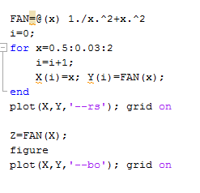
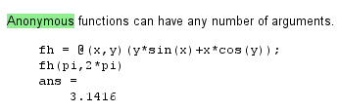


Anonymous Functions
Creates in addition to the set of “canonical” Build-In functions sin(), exp(),… the set of customer build functions.
If vectorized operations used based on Anonymous Function, use dot, specifying this function (see below)
Using fplot instead of plot to plot function

Slide 4
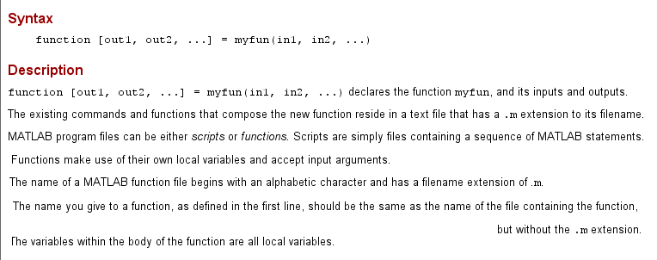

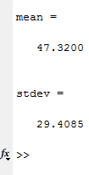

Function

Slide 5
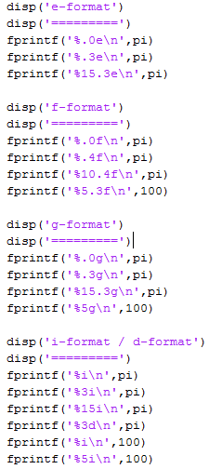
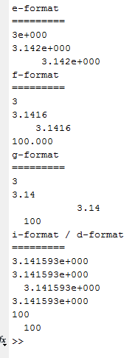
Organized Output. Formats: Integer, Float, Scientific, General

Slide 6
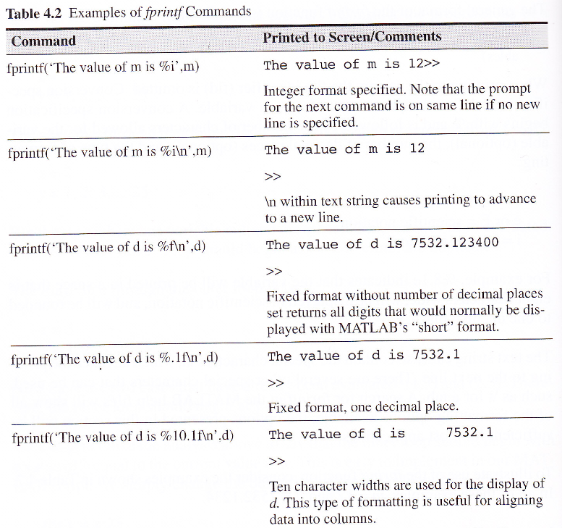
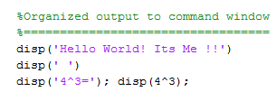

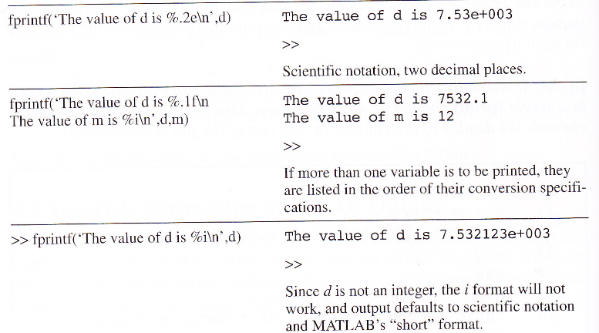
Organized Output to Command Window
m=12; d=7532.1234;
Command: disp
Command : fprintf
Formats:
%d – integer; %i – integer
%f – float Ireal); %c -

Slide 7
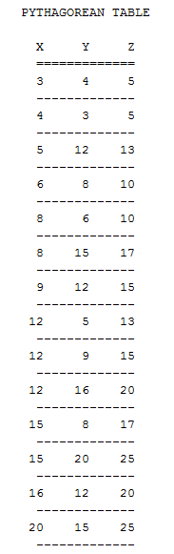
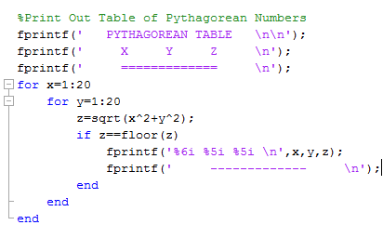
Table Output

Slide 8
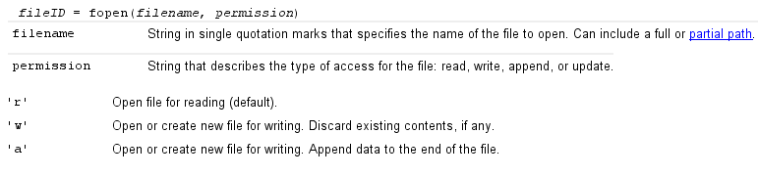
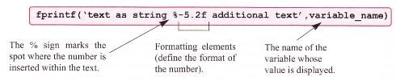
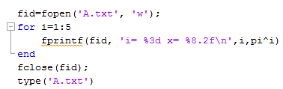
Writing to Files
Open the file
Write to the file
Close the file
Example

Slide 9
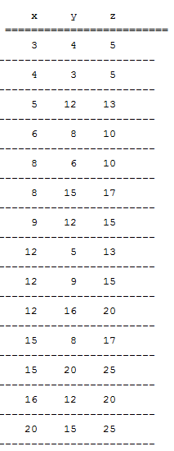
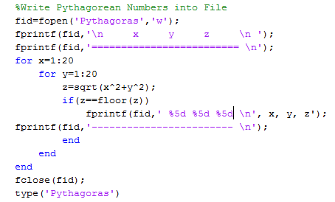
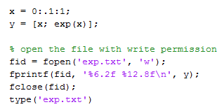
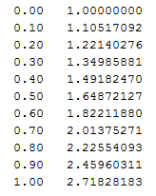
Writing to File. Examples

Slide 10
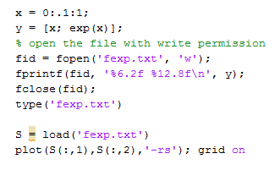
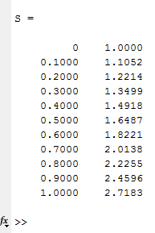
Reading File:Load
The load function reads the file and creates the matrix of the files content. Extract the data from the global matrix, and process

Slide 11
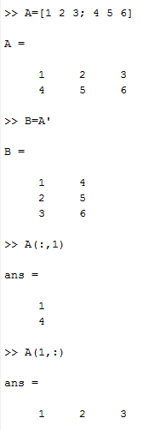
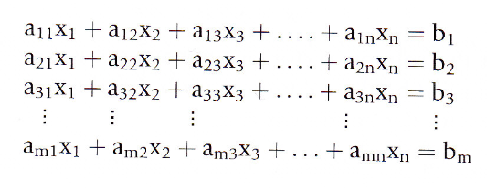

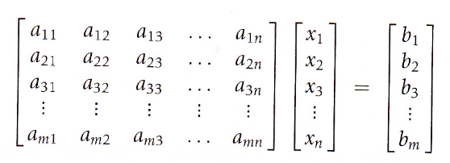
Creating Matrix in MATLAB. From Linear System of Equations to Matrix Equation

Slide 12
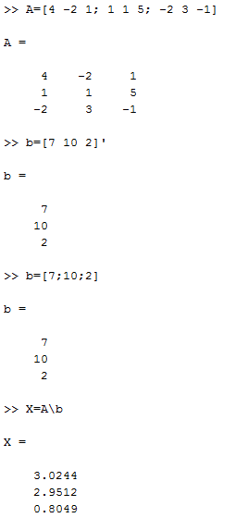
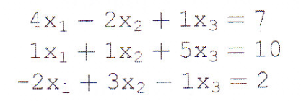
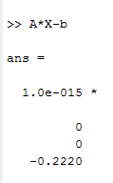
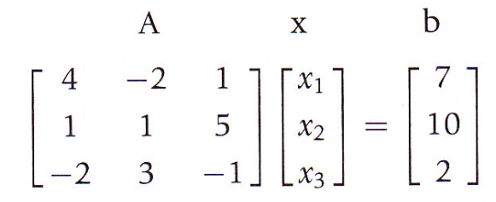
Solving Linear Matrix Equation. Back Slash (\)
Residual

Slide 13
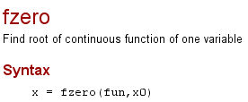
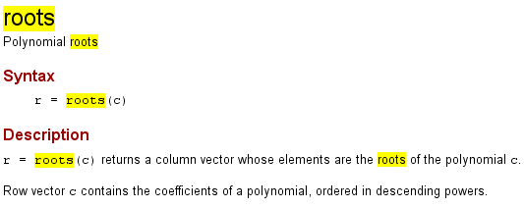
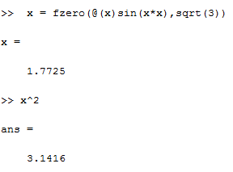
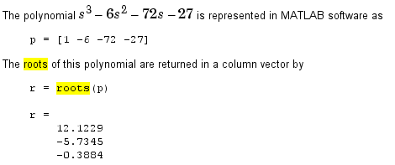
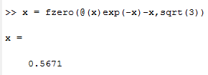

Solving Nonlinear Equations Functions “fzero” (single root) & “roots” (all roots of polynomials)

Slide 14
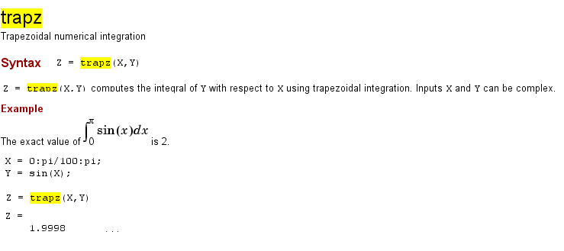
Integration. Function (“trapz”)

